Slide 1
Car Accident Case Study
Final Project

Slide 2
Data Overview
Contains data of around 3.5 million car accidents in the US
Time: Feb 2016 - June 2020
There are 3513617 unique rows and 49 columns
Used Pandas, Numpy, Matplotlib and Seaborn to analyze the data

Slide 3
When did most car accidents occur (day or night?
Surprisingly, to me, most car accidents occurred during the day
2,593,757 car accidents occurred during the day while . 919,745 occurred at night

Slide 4
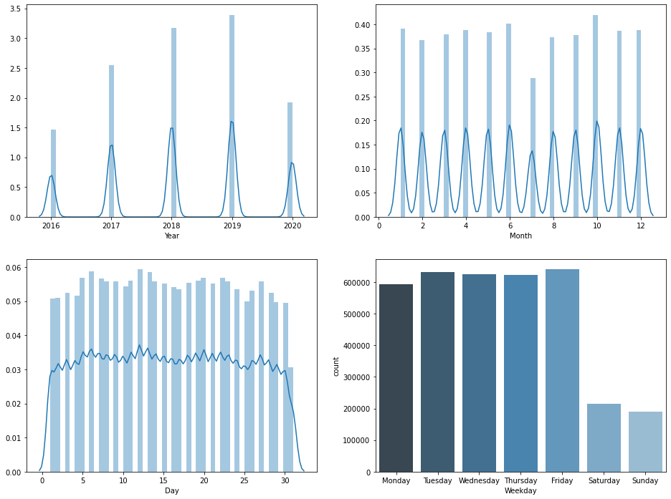
Car accidents in time

Slide 5
Car accidents in time
The most accidents occurred in 2019 at 953,733
2020 is probably on course for the most accidents during this timeframe
Most accidents happened in October
Most accidents seem to occur in the middle of the month
Friday is the day when most accidents occur
Sunday has the least amount of accidents

Slide 6
Severity of car accidents
Severity measures the impact (delay) of the car accident. Most accidents are at a severity of 2.
Severity
1 29174
2 2373210
3 998913
4 112320

Slide 7
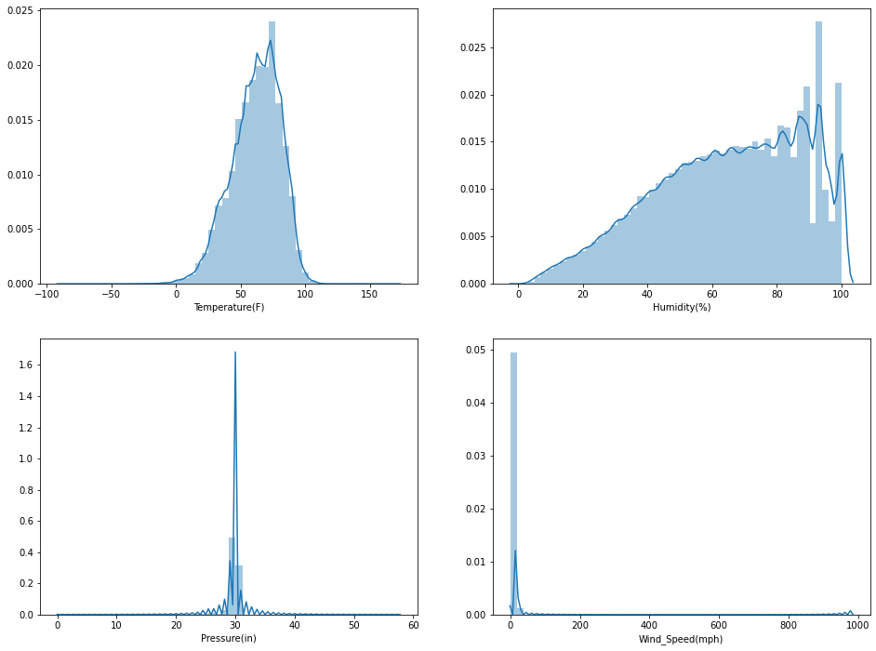
How does weather affect car accidents?

Slide 8
Car accidents and Weather
Wind alone does not seem to have any impact on car accidents
Wind pressure seems to affect cars hauling things, vans, and trucks at 30 inches.
Most accidents seem to happen when the temps are higher than 80 degrees
Humidity also seems to impact accidents above 90%
Most accidents occur when there is a “wintery mix” of rain and snow

Slide 9
Which states had the most car accidents?
California had the most accidents at 816,825
CA, TX, FL, SC and NC are in the top 5
It is believed that population size impacts CA, TX, and FL
SC and NC reports a high number a wreckless drivers
Illinois had 99,692

Slide 10
Lessons Learned
Understanding data preparation, cleansing and wrangling
Let the data speak for itself
Have a plan for what you want to see or prove
There is so much data being tracked
Data analysis will be a great career choice for me

